Slide 1
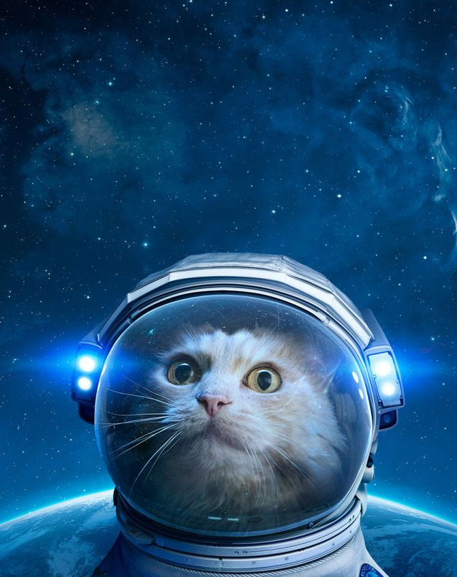
Exploring Rhetoric with
Space cat

Slide 2
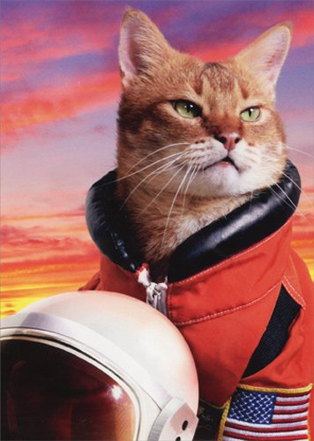
Speaker
Who wrote this?
What do we know about them?
What DON’T we know about them?
Does this text have a particular meaning because of WHO wrote/said it?
Examples: A President giving a speech, a citizen sending a Tweet, a newspaper staff writing an editorial

Slide 3
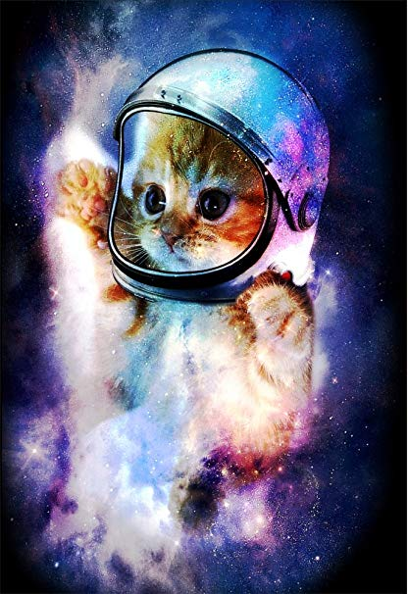
Purpose
What is the speaker hoping to accomplish by putting this out into the world?
Remember that the message itself ≠ the purpose.
Purpose is ALWAYS in terms of audience!1
Examples: to inform, to persuade , to inspire, to convince… IN ORDER to produce a RESPONSE from the AUDIENCE!

Slide 4
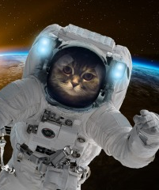
Audience
Who was the actual audience of this text? Was that the intended audience?
What did the speaker assume about their audience? How does that impact what they say and how they say it?
Examples: TV viewers watching a debate, readers of a newspaper, a crowd gathered at a rally

Slide 5
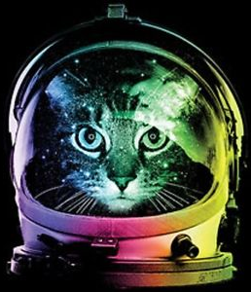
context
What was going on in the world when this text was produced?
What were the biggest issues on the speaker’s mind, which they might be directly or indirectly addressing?
How would this same text be received differently by a different audience in or in a different time?
Examples: MLK’s “I Have a Dream” Speech is given in the context of the Civil Rights Movement

Slide 6
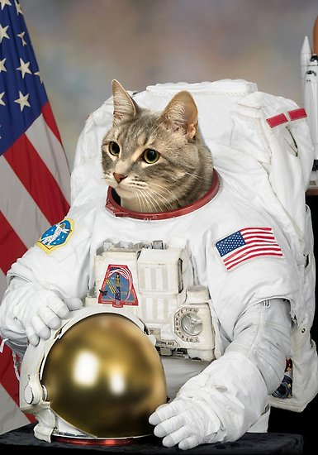
exigence
Why “NOW” for the speaker?
What was the spark or catalyst that moved the speaker to act?
Note that context is “happening” all the time, but usually an event serves as exigence.
Examples: The #MeToo movement taking off after high profile reports of misconduct

Slide 7
choices
This is a CAT-egory of all the little moves authors make to enrich their writing.
Why does the writer make each choice?
Examples: a speechwriter may begin with an anecdote, then move to describing a process of change, and end with a call to action.

Slide 8
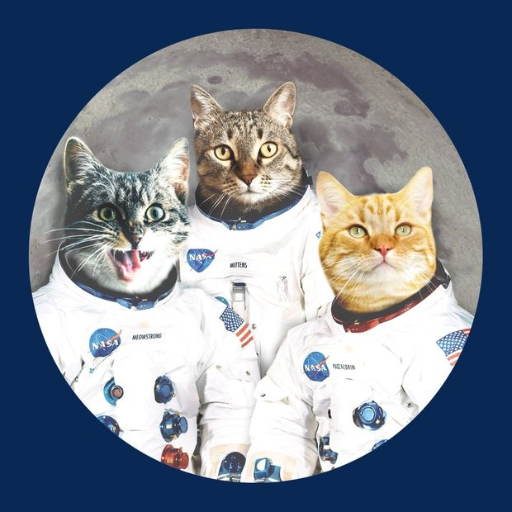
appeals
Appeals to ethics or credibility
Appeals to emotion
Appeals to logic or reason
Examples: Bringing up one’s expertise with the topic (credibility), telling a moving story (emotion), stating facts or statistics (logic)

Slide 9
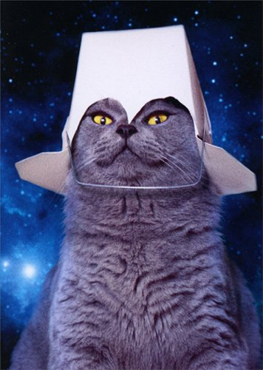
tone
What is the speaker’s attitude at different places throughout the text?
How can you tell this is their attitude?
Where does the tone shift in the piece?
Examples: A religious eulogy may begin with a mournful tone, then move into a comforting or inspirational tone.

Slide 10
When to use space cat?
Rhetorical analysis requires you to read and understand what matters about a text (SPACE) and comment on what specific features make it rich or effective (CAT).
Don’t panic when exploring a new or difficult text…
SPACE CAT will guide you into the unknown!

Slide 11
Space cat was created by heather Crivilare $ the creator claims no copyright on the images or fonts in this PowerPoint. For educational use only.
For more AP Lang fun, check out these other resources from The English Department!

