Slide 1
Core Values of Early Americans

Slide 2
Setting the Scene
How did historical circumstances shape the lives and writings of Early Americans (Puritans) in the New World?
What motivated the earliest settlers to make a dangerous journey from Europe to the New World? What was the Mayflower Compact?
Research the answer to these questions & share here
1
2

Slide 3
Major Ideas
QUESTIONS TO ANSWER
What values and beliefs did the Pilgrims hold dear? How did they view their own trials and tribulations?
What was the Mayflower Compact?

Slide 4
Major Ideas
The Pilgrims often turned to the Bible for comfort. In the Old Testament, they found stories of the struggles and faith of the ancient Israelites.
These stories resonated with the Pilgrims because they saw in them many meaningful parallels to their own situation.
Persecution (Religious freedom)
Flight (Pharaoh/King)
Struggles for Emigration (40yrs desert/Voyage and weather)
The Promised Land (Cannan/New World)

Slide 5
Major Ideas
In their writings, the Pilgrims often highlighted the parallels between themselves and the ancient Israelites. To do this, they used allusions , or references, to the Old Testament.
Because they were devout Christians, the New Testament also played a major part in shaping the Pilgrims' lives and literature.
These ideas and references to the Bible are reflected in the writings of these early settlers. The writers of this period often devoted their energies to praising God and pointing out the ways in which God rewarded those who were devout and punished those who were not.
You may recognize and understand some of the Biblical allusions in the selections that you read. Others, you might not catch. Be sure to read the definitions and explanations for words and phrases in the reading selections. This information will help you understand some of these allusions.

Slide 6
VALUES
The writings of the early American settlers are like a lens through which we can peer back in time.
They also reveal the values and ideals that sustained the settlers as they worked to carve out a new life for themselves and their children.
Three of the principal values were PIETY, COURAGE, AND INDUSTRY.

Slide 7
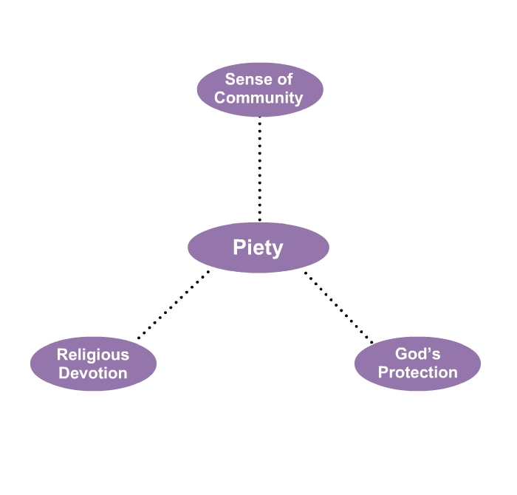
Concerned about the state of people's souls.
Deep respect for God & showing faith through religious observance
Church attendance mandatory
Essential to their continued survival in a threatening new world

Slide 8
Brutal winters
native peoples with unfamiliar ways
individuals who possessed great personal courage would have been able to abandon their homes—and their hemisphere—to travel to an unknown land. Cowardice = shameful & fatal
from the mother country

Slide 9
INDUSTRY
Hunt Animals
Build forts / towns
Store food
Farm crops
In the first American settlements, laziness was not merely an annoying trait. Because all the members of a community depended on each other, one person's laziness could result in serious hardship for all.

